Slide 1
KAZATOMPROM VIRTUAL SCHOOL
eЦРПК

Slide 2
WHAT KAZATOMPROM VIRTUAL SCHOOL IS?
A platform that combines access to the following types of virtual training for JSC «NAC «Kazatomprom» employees:
1. Online training in specialized and corporate programs
2. Online training in KNU’S fellow partners programs
3. Electronic materials and courses developed by KNU for Kazatomprom’s employees
4. KNU E-library
5. E-learning

Slide 3
WHAT KAZATOMPROM VIRTUAL SCHOOL IS?
1. Online training in specialized and corporate programs
c) Center For Development Of Professional Competencies
a) Safety culture
b) Lean production
d) Leadership and continuity culture
e) Internal coaches
f) Culture of responsibility

Slide 4
WHAT KAZATOMPROM VIRTUAL SCHOOL IS?
1. Online training in specialized and corporate programs
a) Safety culture
Module 1 Seminar “Leadership and personal commitment to security” “Behavioral security audit” workshop Working session “Exchange of best practices on prevention of dangerous conditions, dangerous actions, potentially hazardous situations (Near Miss) at JSC “NAC “Kazatomprom” subsidiaries | Module 2 “My route (ACCOUNTABILITY BUILDER) to the formation of personal liability for achievement of organization results” “Methodology of risk assessment - 5 simple steps” workshop Working session “Exchange of best practices on providing an effective management system for occupational health and safety”, case analysis of uranium mine enterprises of the Republic of Kazakhstan
Module 3 “Effective communication influence and persuasion skills” workshop “Deployment of DMAIC-projects (define, measure, analyze improve, control)(in the area of EHS (environment, health, safety)” workshop Working session “Exchange of best practices on ensuring transport security at the enterprise, case analysis of uranium mine enterprises of the Republic of Kazakhstan | Module 4 Seminar “Digital thinking” “Incident management” workshop Working session “Protection of DMAIC-projects ” in the area of EHS”
7 Golden Rules at production enterprise with zero injuries and safe working conditions
1 Become a Leader – to show commitment
2 Depict threats – to control risks
3 Define goals – to develop programs
4 Constantly improve the production safety system - to achieve a high level of organization
5 Ensure the production safety at working places while operating equipment and handling of dangerous substances
6 Improve skills - develop professional skills
7 Invest in human resources-motivate through participation

Slide 5
WHAT KAZATOMPROM VIRTUAL SCHOOL IS??
1. Online training in specialized and corporate programs
b) Lean production
Managing the mine's value stream: developing an "As is" model»
Managing the mine's value stream: developing a target model of the cause-and-effect chains, forming the company's project portfolio
Managing the mine's value stream: presentation of the target and operational model of cause-and-effect chains and the company's project portfolio
Project management using the DMAIC methodology
Storm-break in A3 format
DMAIC project management practice in production
A3 project management practice in production
Project management using DMAIC and A3 methodology: presentation of company projects
Organizing and conducting self-assessment according to the criteria of the " Kazatomprom-2020 Award»

Slide 6
WHAT KAZATOMPROM VIRTUAL SCHOOL IS?
1. Online training in specialized and corporate programs
c) Center for Development of Professional Competencies
Brief description of geophysical research method
Geophysical research at various stages of work
Calculation of the mining mass.
Geotechnological parameters of the operational block.
Calculation of the main geotechnical parameters of the the operational block.
Dynamics of the movement of solutions in the process of underground leaching.
Chemistry, mechanism of underground well leaching processes.
The construction of the production wells.
Filters of technological wells.
Systems for opening uranium deposits.
Methods of acidification of uranium deposits.
Operating modes of production wells.
Acid consumption rates at different stages of leaching.
Methods for preventing colmatation

Slide 7
WHAT KAZATOMPROM VIRTUAL SCHOOL IS?
1. Online training in specialized and corporate programs
d) Leadership and continuity culture
Personal effectiveness. Personal effectiveness tools
The efficiency of the command. Tools for team effectiveness
Team identification of problems and identification of solutions
Skills of an effective Manager. The leader's path
Digital thinking
Leader as a mentor
Public speaking skills
Presentation and public speaking skills
Development of innovative thinking
Managing team performance and energy
Effective communication

Slide 8
WHAT KAZATOMPROM VIRTUAL SCHOOL IS?
1. Online training in specialized and corporate programs
e) Internal coaches
1 | Istleeva Saule | «Basics of personnel management. Interview on competencies» | JSC NAC «KAZATOMPROM»
2 | Saidalina Nurbala | «Fundamentals of the organization of internal audit»
3 | Tulebayev Bekzat | «IT management»
4 | Iskak Orazbek | «Marketing basics in uranium industry»
5 | Sakharova Elena | «Corporate management Foundation»
6 | Ibragimova Elena | «Labour dispute. Conciliation commission »
7 | Ashikova Kulyash | «Taxation of personal income »
8 | Turakbayeva Malika | Work with investors. Introduction
9 | Нурбердиева Гульзина | What compliance is?
10 | Yelekeev Erbol | «Ensuring industrial safety at uranium mining enterprises»
11 | Berikbolov Zholaman | «Kazatomprom’s activity in the field of environment protection»
12 | Kimolayev Zhanat | «Radiation Safety at uranium mines»
13 | Abramova Oksana | «Stages of internal audit planning» | LLC «Volkovgeology»
14 | Zadorozhnaya Elena | «Documentation of core-samples of infiltration deposits of uranium suitable for ISL field mining»
15 | Shalbayev Zhenis | «Drilling and construction of technological wells, drilling fluids»
16 | Chen Oleg | «Occupational safety and health» | LLP «Southern mining chemical company»
17 | Ryskaliev Bekzhan | «Implementation results and relevance of energy saving and energy efficiency measures»
18 | Бекишев Женис | «АО «НАК «Казатомпром» структура и деятельность» | LLP «Кaratau»
19 | Shabalina Ludmila | «Schematic diagram of the annual mining development plan» | LLP “Baiken-U"
20 | Zimin Sergey | «Scheme of the opening of production blocks» | LLP “Subsidiary“Ortalyk
21 | Dzhakupov Daniyar | «Uranium mining process» | LLP «Semizbai-U"
22 | Mendygaliev Adil | «Predicting, searching, evaluation and exploration of infiltration uranium deposits» | LLP«IHT»
23 | Permenev Yuriy | «Environmental and social action plan»
24 | Zhailybayeva Akmaral | «Financial literacy is the key to a prosperous future»
25 | Danya Dzhamankulova | «Method for calculating of local content» | Branch of LLP«IHT» «КNU»
26 | Graf Alexandra | «Main equipment in mines»

Slide 9
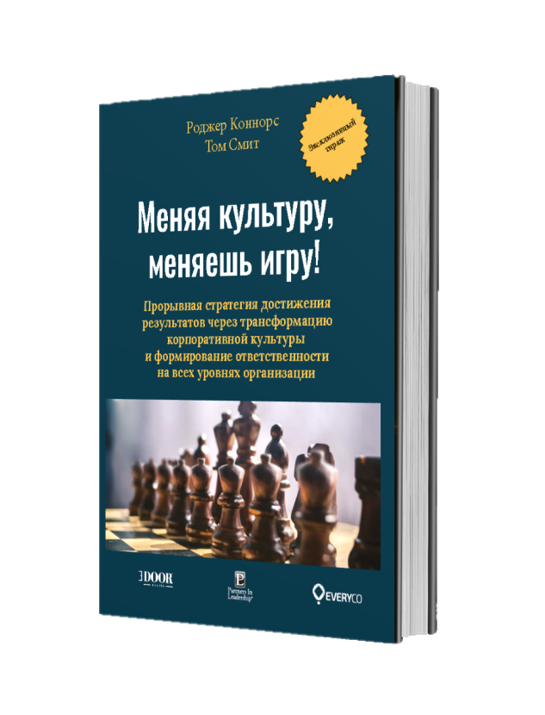
WHAT KAZATOMPROM VIRTUAL SCHOOL IS?
1. . Online training in specialized and corporate programs
f) Culture of responsibility
Program | My route (ACCOUNTABILITY BUILDER) | Our route (Lead Culture) | Their route (Leadership Builder)
Focus | 3-4 key results of the organization in the short term(12-18 months) | Long-term key results and growth goals (for example, achieving goal 0 for injuries) | Setting and managing expectations
When you need it? | When it is necessary for employees to feel responsible for achieving the organization's key results | When You need a culture that is connected to your long-term strategic goals and gives You the opportunity to achieve them | When You need an energetic team where employees successfully complete tasks and implement initiatives, leading the entire company to success
Result | Employees are motivated to close gaps in responsibility that affect the achievement of key results | A culture of responsibility has been created in which people think and act in such a way as to achieve the desired results | To meet key expectations, employees help each other maintain the necessary level of responsibility (when failure to complete a task is not even considered
book | The Oz Principle: Getting Results Through Individual and Organizational Accountability. Roger Connors, Tom Smith, Craig Hickman | Change the Culture, Change the Game: The Breakthrough Strategy for Energizing Your Organization and Creating Accountability for Results. Roger Connors , Tom Smith | How Did That Happen?: Holding People Accountable for Results the Positive, Principled Way. Roger Connors, Tom Smith

Slide 10
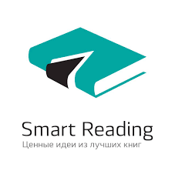
WHAT KAZATOMPROM VIRTUAL SCHOOL IS?
2. Online training programs of KNU partners

Slide 11
WHAT KAZATOMPROM VIRTUAL SCHOOL IS?
3. E-courses developed by KNU’s employees for Kazatomprom’s employees
E-course " Introductory instruction on occupational health and safety for office employees»
Electronic course «Fundamentals of uranium mining and processing»
Video clip on the topic «Security Minute»
Electronic course of the center for development of professional competencies

Slide 12
WHAT KAZATOMPROM VIRTUAL SCHOOL IS?
4. KNU electronic library
SELF-DEVELOPMENT
PROJECT MANAGEMENT
STRATEGY
HR-MANAGEMENT
TIME MANAGEMENT
MARKETING, SALES
Economics, Finances
SCIENCE
PSYCOLOGY

Slide 13
WHAT KAZATOMPROM VIRTUAL SCHOOL IS?
5. Distance learning system
Executives
HR-MANAGERS
Workforce
Employee training status
Plan-fact of the training budget
% compliance of employees with the current position
Reduction of travel expenses
The appointment books of employees, monitoring of reading progress
Generating reports based on the specified templates
Online and offline training courses
Training statistics in monetary and physical terms
Full database of professional directions, positions, training programs, tests, coaches
Communication courses with a matrix of competencies
Ability to take courses "in parts“
Online testing
Remote access to knowledge 24/7
Training line
All certificates in the "Cabinet“
Notification about start of the training
Summaries of all the books in «Smart Reading»

Slide 14
ADVANTAGES OF VIRTUAL SCHOOL
1. Online training in specialized and corporate programs
Target use of the Company's training budget
Focus on developing employee competencies necessary to achieve the company's business goals
Consistency of training
2. Online training programs of KNU partners
Wide coverage of market offers in the field of virtual learning
Exclusive training conditions for international programs
A single entry point for all offers from KNU partners
3. Electronic materials and courses developed by the KNU for the employees of Kazatomprom
The materials are fully adapted to the specifics of Kazatomprom and the needs of employees
Effective adaptation of new employees
Involvement of non-core specialists in the specifics of the company's activities
4. KNU E-library
БFree access to popular e-books in various fields
Ability to download e-books to personal devices
5. Distance learning system
24/7 training from anywhere in the world
For managers and HR managers-monitoring and monitoring the progress of employee training (reports)
Training planning, competency assessment

